Slide 1

Peripheral & Interfacing LAB
MORSE-CODE
Md. Hasibur Rahman
Reg. No: Md. Hasibur Rahman
Sec: A

Slide 2
CONTENT
1
Introduction
3
Working Procedure
2
Components
1

Slide 3
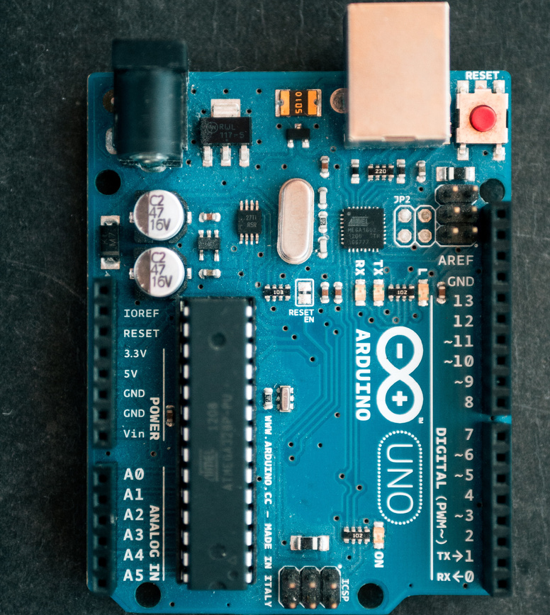
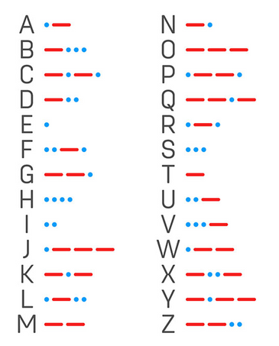
INTRODUCTION
Morse Code.
Motivation
Why?
2

Slide 4
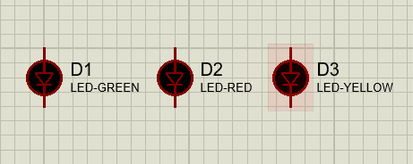
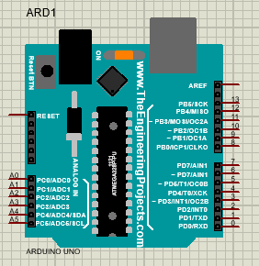
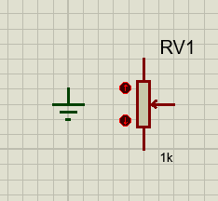
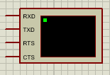
COMPONENT
3. 3 -LED light
Software:
i. Proteus
ii. Arduino
1
Hardware:
Proteus built in hardware components.
2
1. Arduino UNO
2. Ground, Register & wire
4. Virtual Terminal
3

Slide 5
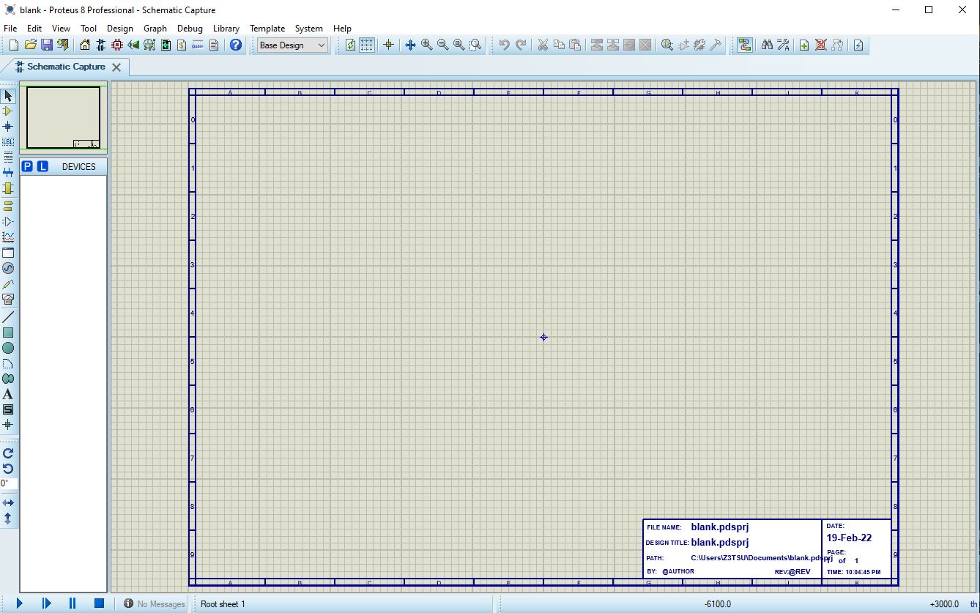
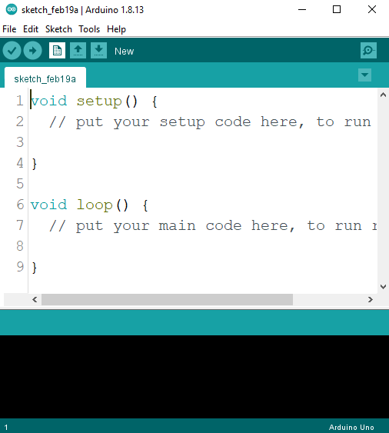
WORKING PRECEDURE
How i will implement this project?
Proteus simulation
Arduino code
4

Slide 6
- .... .- -. -.-
-.-- --- ..-!
Have a great day ahead.

